Slide 1
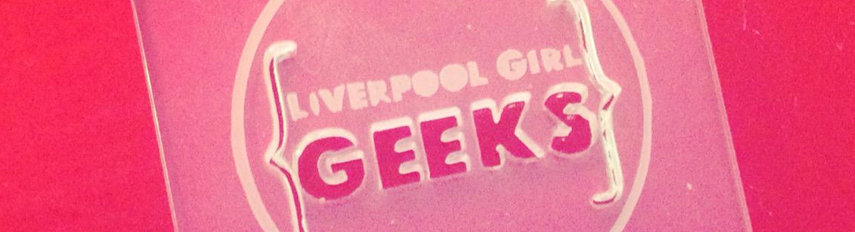


Introducing basic tags, attributes and elements.
#getyourheadaroundcode @lpoolgirlgeeks

Slide 2
Hypertext MarkUp Language (HTML)
HTML is a markup language that describes the structure and semantic content of a web document.
Content within a web page is tagged with HTML elements.
These elements form the building blocks of a website.
#getyourheadaroundcode @lpoolgirlgeeks

Slide 3
Introducing tags...
LEFT-ANGLE BRACKET
<p></p>
LEFT-ANGLE BRACKET
RIGHT-ANGLE BRACKET
RIGHT-ANGLE BRACKET
FORWARD SLASH
The characters in the brackets indicate the tag’s purpose.
For example, in the tags above the p stands for paragraph.
#getyourheadaroundcode @lpoolgirlgeeks

Slide 4
Introducing elements...
<p>Liverpool Girl Geeks!</p>
OPENING TAG
CLOSING TAG
Each element has an opening tag and a closing tag.
The element is everything from the opening tag to the closing tag.
#getyourheadaroundcode @lpoolgirlgeeks

Slide 5
Introducing empty elements...
<img src="myimage.jpg" alt="my image">
Also known as self-closing elements.
#getyourheadaroundcode @lpoolgirlgeeks

Slide 6
Introducing Attributes...
ATTRIBUTE VALUE
ATTRIBUTE VALUE
<img src="myimage.jpg" alt="my image">
ATTRIBUTE NAME
ATTRIBUTE NAME
The attribute name indicates what kind of extra information you are supplying about the element's content.
The value is the information or setting for the attribute.
Different attributes can have different values.
#getyourheadaroundcode @lpoolgirlgeeks

Slide 7
Basic requirements of a web page...
doctype
<html> tag
<head> tag
<title> tag
<body> tag
#getyourheadaroundcode @lpoolgirlgeeks

Slide 8
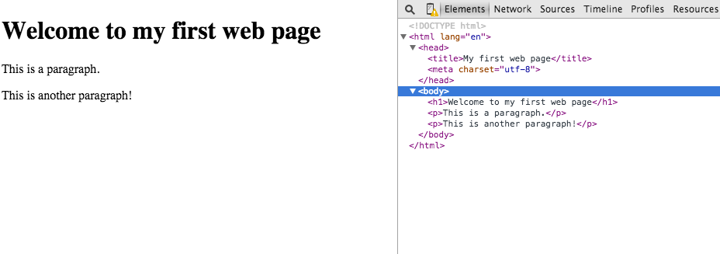
Your first web page...
#getyourheadaroundcode @lpoolgirlgeeks

